Slide 1
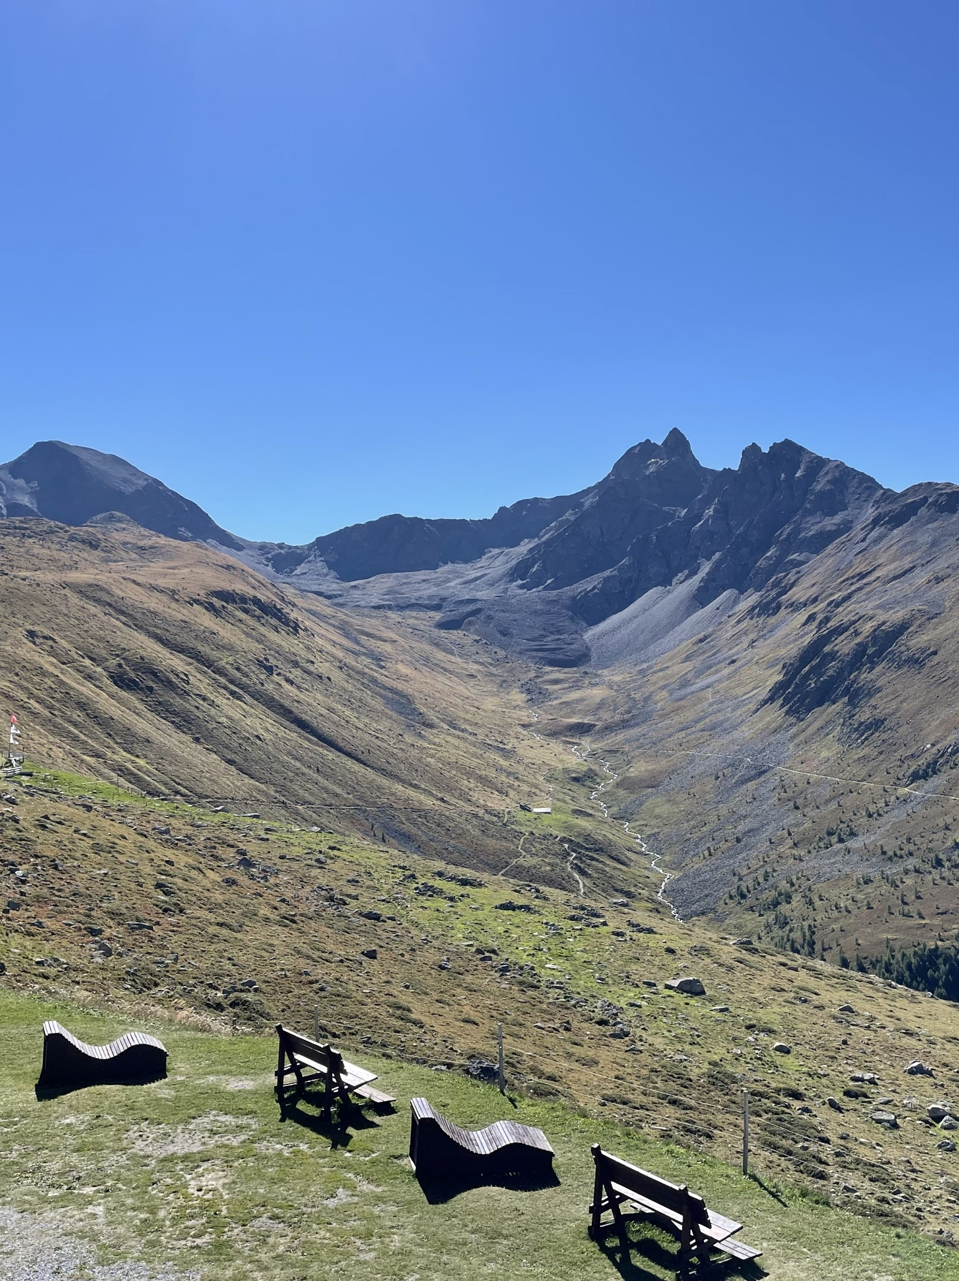


3-5 September 2025
SGmG/SSGm Symposium
Understanding landscape changes
Landscapes in Switzerland as well as in other parts of the world have witnessed distinct geomorphological changes in recent years, mainly in reaction to climate-related changes. In our Society we contribute to the understanding of these changes in various ways: through the quantification of landform changes and the analysis of related processes and impacts, the observation of spatio-temporal patterns or trends of landform changes, and through the communication of the results to the wider public.
We kindly invite our members as well as colleagues from neighbouring disciplines to this symposium to present and exchange on recent findings and observations! The meeting is kindly hosted by the Swiss National Parc in Zernez; it was the intention to hold this meeting in the Engadine, as we also want to celebrate the award to the «Rock glaciers of the Engadine» as one of the First 100 IUGS Geological Heritage Sites. The keynote, several contributions, and the excursion are dedicated to the rock glaciers of the Engadine.

Slide 2
3-5 September 2025
SGmG/SSGm Symposium
Understanding landscape changes
Program
Wed 03.09. 20.30 Public lecture & Apéro (in German)
Dr. Stefanie Gubler (SCNAT): Die weltweit längste Blockgletscher-
Beobachtungsreihe: Erkenntnisse aus über 100 Jahre Forschung
im Schweizerischen Nationalpark
Thu 04.09. Symposium «Understanding landscape changes»
9.00-17.00 Oral & poster presentations, coffee breaks & lunch
18.00 Dinner at Hotel Pizzeria Selva
Location Nationalparkzentrum, 7530 Zernez
Fri 05.09. 9.00 Excursion to Val Muragl & Pontresina (public)
Meeting at Punt Muragl (valley station of the cable car)
hike to rock glacier Muragl, picnic (bring your own!), hike to Pontresina with several stops (avalanche protection structures, debris flow dam, glacier changes (Val Roseg), etc.)
16.00 End in Pontresina
There is the option to leave the group earlier (after picnic) and return to Punt Muragl (by cablecar).
Sat 06.09. Excursion Young Geomorphologists

Slide 3
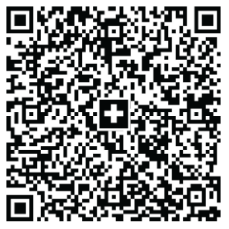
3-5 September 2025
SGmG/SSGm Symposium
Understanding landscape changes
Practical information
Costs The conference fee includes the public lecture with Apéro and the symposium day with all meals. The excursion is public and therefore not included (we will organize group tickets for a reduced price on site).
Student (30*/50 CHF), PhD (50*/70 CHF), Senior (90*/120 CHF)
* for SGmS members
Registration details www.geomorphology.ch or direct link
Registration deadline June 30, 2025
Abstract deadline June 30, 2025 (send abstract to isabelle.roer@geo.uzh.ch)
Payment details QR-Bill:
SGmG / SSGm / SGmS
Ch. du Levant 5
1926 Fully
IBAN: CH78 0900 0000 8004 6505 2

